Slide 1
Email Security
Email is one of the most widely used and regarded network services
currently message contents are not secure
  may be inspected either in transit
  or by suitably privileged users on destination system
Notes:
In virtually all distributed environments, electronic mail is the most heavily used network-based application. But current email services are roughly like "postcards”, anyone who wants could pick it up and have a look as its in transit or sitting in the recipients mailbox.

Slide 2
Email Security Enhancements
confidentiality
  protection from disclosure
authentication
  of sender of message
message integrity
  protection from modification
non-repudiation of origin
  protection from denial by sender
Notes:
With the explosively growing reliance on electronic mail for every conceivable purpose, there grows a demand for authentication and confidentiality services. What we want is something more akin to standard mail (contents protected inside an envelope) if not registered mail (have confidence about the sender of the mail and its contents). That is, the “classic” security services listed are desired.

Slide 3
Pretty Good Privacy (PGP)
widely used de facto secure email
developed by Phil Zimmermann
selected best available crypto algs to use
integrated into a single program
on Unix, PC, Macintosh and other systems
originally free, now also have commercial versions available
Notes:
The Pretty Good Privacy (PGP) secure email program, is a remarkable phenomenon, has grown explosively and is now widely used. Largely the effort of a single person, Phil Zimmermann, who selected the best available crypto algorithms to use & integrated them into a single program, PGP provides a confidentiality and authentication service that can be used for electronic mail and file storage applications. It runs on a wide range of systems, in both free & commercial versions.

Slide 4
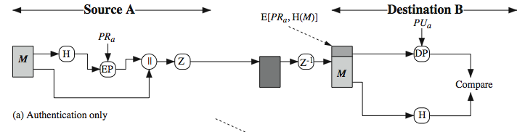
PGP Operation – Authentication
sender creates message
make SHA-1160-bit hash of message
attached RSA signed hash to message
receiver decrypts & recovers hash code
receiver verifies received message hash
Notes:
The actual operation of PGP, as opposed to the management of keys, consists of four services: authentication, confidentiality, compression, and e-mail compatibility. Stallings Figure 18.1a illustrates the digital signature service provided by PGP. This is the digital signature scheme discussed in Chapter 13 and illustrated in Figure 13.2. The sequence is as listed. Note this assumes use of RSA digital signatures, created using the sender's private key, and verified with the sender's public key. Recent PGP versions also support the use of DSS signatures. Signatures can also be detached from a message/file and sent/stored separately. This can be useful to maintain a separate signature log of all messages sent or received; or on an executable program to detect subsequent virus infection, or when more than one party must sign a document.

Slide 5
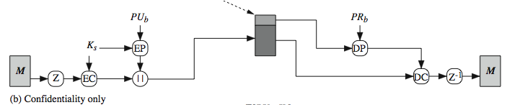
PGP Operation – Confidentiality
sender forms 128-bit random session key
encrypts message with session key
attaches session key encrypted with RSA
receiver decrypts & recovers session key
session key is used to decrypt message
Notes:
Another basic service provided by PGP is confidentiality, provided by encrypting messages to be transmitted or to be stored locally as files, using symmetric encryption algorithms CAST-128, IDEA or 3DES in 64-bit cipher feedback (CFB) mode. The randomly chosen session key used for this is sent encrypted using the recipient’s public RSA key. The steps used in this process are as listed. Stallings Figure 18.1b illustrates the sequence. Recent PGP versions also support the use of ElGamal (a Diffie-Hellman variant) for session-key exchange.

Slide 6
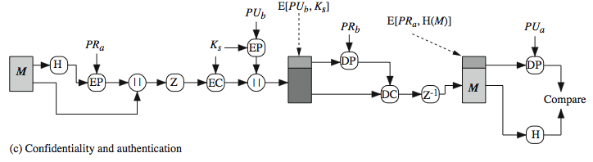
PGP Operation – Confidentiality & Authentication
can use both services on same message
  create signature & attach to message
  encrypt both message & signature
  attach RSA/ElGamal encrypted session key
Notes:
As Stallings Figure 18.1c illustrates, both confidentiality & authentication services may be used for the same message. Firstly a signature is generated for the plaintext message and prepended to the it. Then the plaintext message plus signature is encrypted using CAST-128 (or IDEA or 3DES), and the session key is encrypted using RSA (or ElGamal). This sequence is preferable to the opposite: encrypting the message and then generating a signature for the encrypted message. It is generally more convenient to store a signature with a plaintext version of a message. Furthermore, for purposes of third-party verification, if the signature is performed first, a third party need not be concerned with the symmetric key when verifying the signature. In summary, when both services are used, the sender first signs the message with its own private key, then encrypts the message with a session key, and then encrypts the session key with the recipient's public key.

Slide 7
PGP Operation – Compression
by default PGP compresses message after signing but before encrypting
  so can store uncompressed message & signature for later verification
  & because compression is non deterministic
uses ZIP compression algorithm
Notes:
By default PGP compresses the message after applying the signature but before encryption. This has the benefit of saving space both for e-mail transmission and for file storage. The signature is generated before compression for the reasons shown. The compression algorithm used is ZIP, and is indicated by Z for compression and Z–1 for decompression in Figure 18.1. It is described in Online Appendix O.

Slide 8
PGP Operation – Email Compatibility
when using PGP will have binary data to send (encrypted message etc)
however email was designed only for text
hence PGP must encode raw binary data into printable ASCII characters
uses radix-64 algorithm
  maps 3 bytes to 4 printable chars
  also appends a CRC
PGP also segments messages if too big
Notes:
When PGP is used, at least part of the block to be transmitted is encrypted, and thus consists of a stream of arbitrary 8-bit octets. However many electronic mail systems only permit the use of ASCII text. To accommodate this restriction, PGP provides the service of converting the raw 8-bit binary stream to a stream of printable ASCII characters. It uses radix-64 conversion, in which each group of three octets of binary data is mapped into four ASCII characters. The use of radix 64 expands a message by 33%. Fortunately, the session key and signature portions of the message are relatively compact, and the plaintext message has been compressed, often by more than enough to compensate for the radix-64 expansion. This format also appends a CRC to detect transmission errors. See Stallings Appendix 18A for a description.
PGP also automatically subdivides a message that is too large for a single email, into segments that are small enough to send.

Slide 9
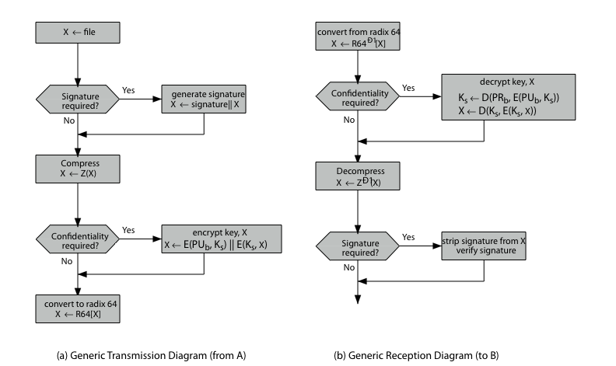
PGP Operation – Summary
Notes:
Stallings Figure 18.2 illustrates the general operation of PGP, and the relationship between the services discussed. On transmission, if it is required, a signature is generated using a hash code of the uncompressed plaintext. Then the plaintext, plus signature if present, is compressed. Next, if confidentiality is required, the block (compressed plaintext or compressed signature plus plaintext) is encrypted and pre-pended with the public-key-encrypted symmetric encryption key. Finally, the entire block is converted to radix-64 format.
On reception, the incoming block is first converted back from radix-64 format to binary. Then, if the message is encrypted, the recipient recovers the session key and decrypts the message. The resulting block is then decompressed. If the message is signed, the recipient recovers the transmitted hash code and compares it to its own calculation of the hash code.

Slide 10
PGP Session Keys
need a session key for each message
  of varying sizes: 56-bit DES, 128-bit CAST or IDEA, 168-bit Triple-DES
generated using ANSI X12.17 mode
uses random inputs taken from previous uses and from keystroke timing of user
Notes:
PGP makes use of four types of keys: one-time session symmetric keys, public keys, private keys, and passphrase-based symmetric keys.
Each session key is associated with a single message and is used only for the purpose of encrypting and decrypting that message, using a symmetric encryption algorithm, such as CAST-128 and IDEA with 128-bit keys; or 3DES with a 168-bit key. Random numbers are generated using the ANSI X12.17 generator, with inputs based on keystroke input from the user, where both the keystroke timing and the actual keys struck are used to generate a randomized stream of numbers. Stallings Online Appendix P discusses PGP random number generation techniques in more detail.

Slide 11
PGP Public & Private Keys
since many public/private keys may be in use, need to identify which is actually used to encrypt session key in a message
  could send full public-key with every message
  but this is inefficient
rather use a key identifier based on key
  is least significant 64-bits of the key
  will very likely be unique
also use key ID in signatures
Notes:
Since many public/private keys may be in use with PGP, there is a need to identify which key is actually used to encrypt the session key for any specific message. You could just send the full public-key with every message, but this is inefficient. Rather PGP use a key identifier based on the least significant 64-bits of the key, which will very likely be unique. Then only the much shorter key ID would need to be transmitted with any message. A key ID is also required for the PGP digital signature.

Slide 12
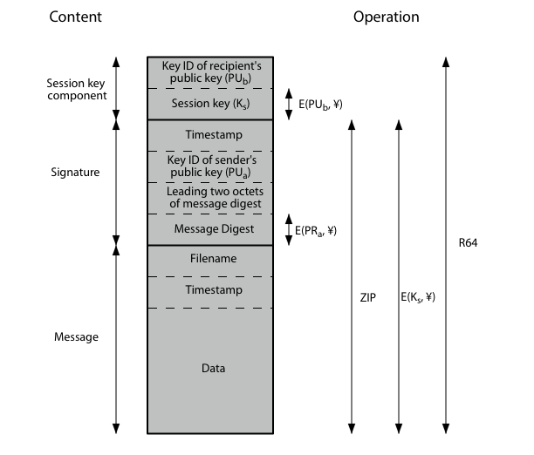
PGP Message Format
Notes:
Stallings Figure 18.3 shows the format of a transmitted PGP message. A message consists of three components: the message component, a signature (optional), and a session key component (optional). The message component includes the actual data to be stored or transmitted, as well as a filename and a timestamp that specifies the time of creation. The signature component includes a timestamp, encrypted SHA-1 message digest, leading two digest octets for verification, and the Key ID of the sender’s public key. The session key component includes the session key and the identifier of the recipient's public key that was used by the sender to encrypt the session key. The entire block is usually encoded with radix-64 encoding.

Slide 13
S/MIME (Secure/Multipurpose Internet Mail Extensions)
security enhancement to MIME email
  original Internet RFC822 email was text only
  MIME provided support for varying content types and multi-part messages
  with encoding of binary data to textual form
  S/MIME added security enhancements
have S/MIME support in various modern mail agents: MS Outlook, Netscape etc

Slide 14
S/MIME Functions
enveloped data
  encrypted content and associated keys
signed data
  encoded message + signed digest
clear-signed data
  cleartext message + encoded signed digest
signed & enveloped data
  nesting of signed & encrypted entities

Slide 15
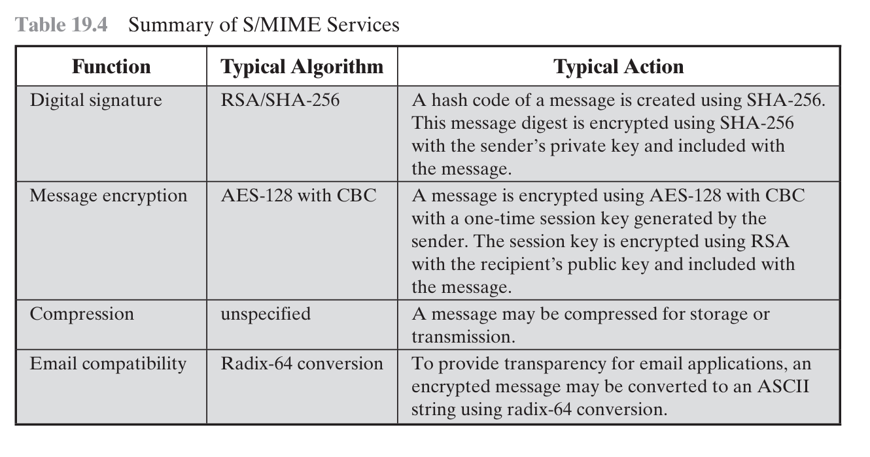

Slide 16
S/MIME Cryptographic Algorithms
hash functions: SHA-1 & MD5
digital signatures: DSS & RSA
session key encryption: ElGamal & RSA
message encryption: Triple-DES, RC2/40 and others
have a procedure to decide which algorithms to use

Slide 17
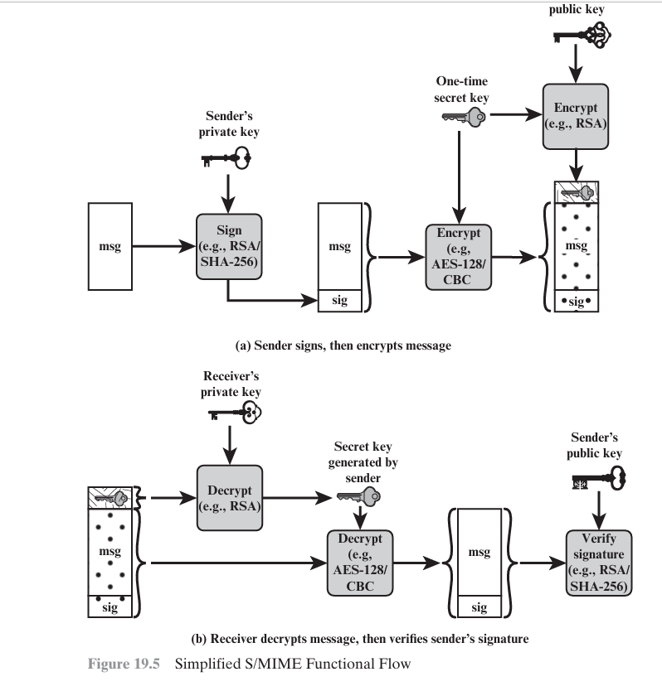

Slide 18
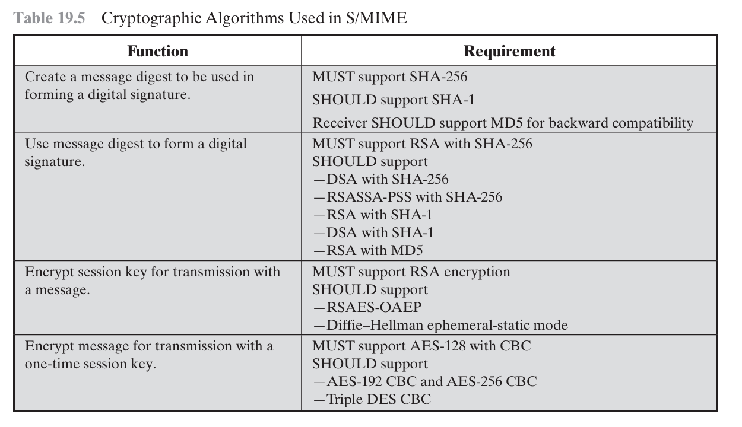

Slide 19
S/MIME Certificate Processing
S/MIME uses X.509 v3 certificates
managed using a hybrid of a strict X.509 CA hierarchy & PGP’s web of trust
each client has a list of trusted CA’s certs
and own public/private key pairs & certs
certificates must be signed by trusted CA’s

Slide 20
Certificate Authorities
have several well-known CA’s
Verisign one of most widely used
Verisign issues several types of Digital IDs
with increasing levels of checks & hence trust
  Class Identity Checks Usage
  1 name/email check web browsing/email
  2+ enroll/addr check email, subs, s/w validate
  3+ ID documents e-banking/service access

